Slide 1


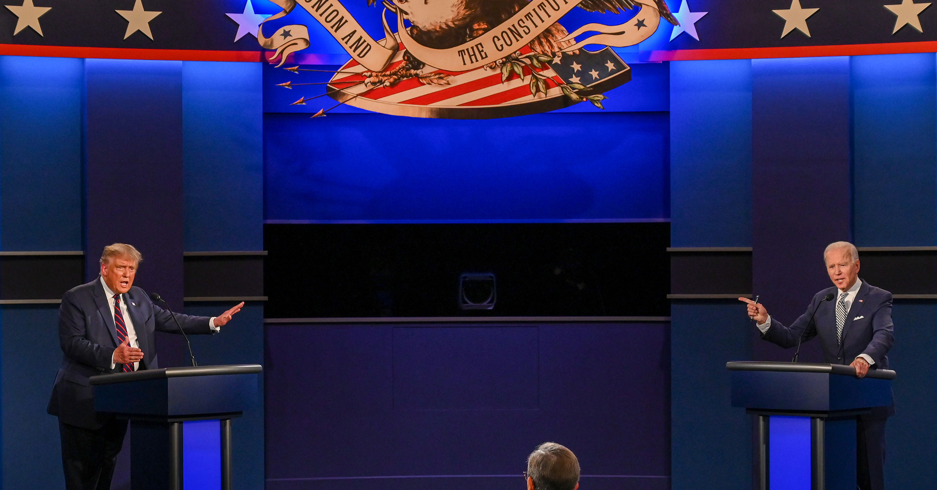

ANALYSIS ON US ELECTION USING SOCIAL MEDIA
TEAM MEMBERS
NIKHITHA, KOLLURI
ESWAR, VALLURU
CHAITANYA, MALLEPUDI
SRI SAI NITHIN CHOWDARY, DUKKIPATI

Slide 2
MOTIVATION
The world has been advancing significantly day by day, so as the data. Nowadays the data has become so vast such that it could not be stored in a single cluster or a machine, thus the concept of big data arisen and its services have been implemented in various sectors. Many tools and technologies are arriving in the market very frequently to work with this big data. We thought of analysing social media data using the existing techniques, visualize the data, aggregate, and model it in a user-friendly way.

Slide 3
Idea
Since the media is biased most of the times, it is difficult for the users to get the aggregation of all the views across the globe. We have Big Data technologies to deal with large amount of data and perform analytics. So we choose the collect the social media(twitter) data, analyse and aggregate the views on US Elections and make it presentable to the user with friendly interface.

Slide 4
WHO?
People who are curious about the 2020 US Elections inside as well as outside the United States.

Slide 5
WHAT ?
People want to get awareness on elections/after elections; since the media is always biased, people are unable to get the aggregate information and make the decision.

Slide 6
WHEN?
When people want to know whether the media and people are on the same stand.

Slide 7
WHERE?
Across the globe where people want to know the actual views on any trending issues.

Slide 8
WHY?
Since the Media is biased and mainly focusing on their ratings instead of the ground truth being represented to the people.

Slide 9
HOW & WHAT DATA?
Streaming the Twitter data using tweepy.
Retrieving data using keywords which are related to both.
Filtering the extracted data for vital columns.
Performing Sentimental analysis on filtered data.

Slide 10
TOOLS & TECNOLOGIES
PYTHON : Extracting data.
HIVE/SPARK : Filtering and Analyzing data.
SPARK STREAMING: Streaming the live data
HADOOP : Storing the data.
SOLR : Loading and Analyzing the data.
TextBlob: Sentimental analysis.
FLASK: Web Interface.
AWS : Cloud platform.

Slide 11
OBJECTIVES
Our Undertaking fundamental thought is to do the ETL cycle utilizing Hive/Spark Query Handling, Cleaning the data, Understand the nature of data, then stream the data, performs sentimental analysis, visualizing the Polarity, and Incorporating visualization with Web UI. The wellspring of our framework is Twitter information and we would utilize Tweepy API to gather the information. We would deploy the web UI incorporating the visualizations in the Cloud environment.

Slide 12
SIGNIFICANCE
People are very curious about the recent trending issues across the globe, Since the 2020 US elections have been trending now the people want to know about the different views across the country on participating election candidates. So, we are collecting social media data to analyse different views and opinions, so that people can get awareness.

Slide 13
FEATURES
This project includes streaming of live twitter data and processing it through SPARK/HIVE and using TextBlob from NLTK to process the data and predict the sentiment and Creating a Web UI incorporating the visualization of data and deploying it to the Cloud environment.

Slide 14
APPLICATIONS
Getting out the collaborative results.
To know what’s going during/after an event/crisis.
To get radical updates on ongoing issues.

Slide 15
PROJECT WORKFLOW

Slide 16
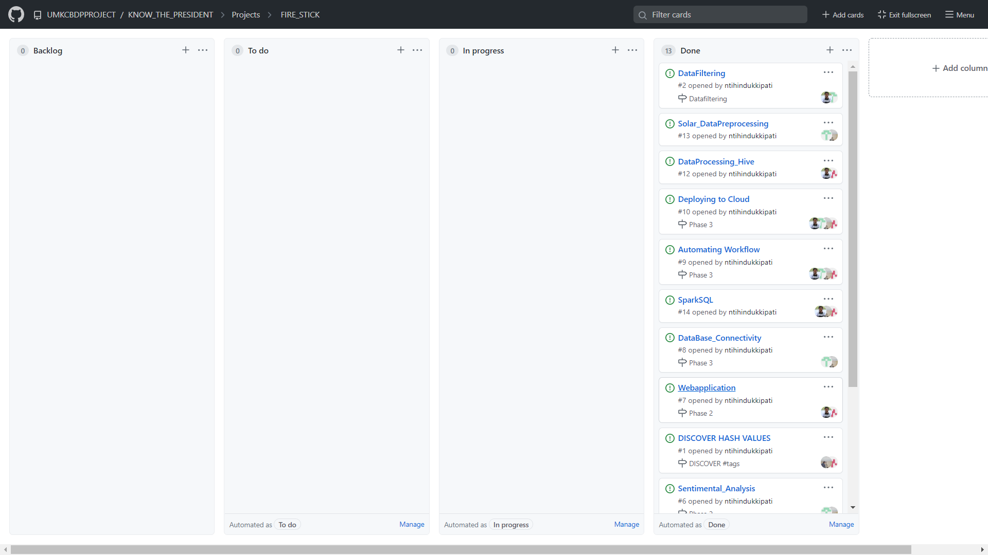

Slide 17
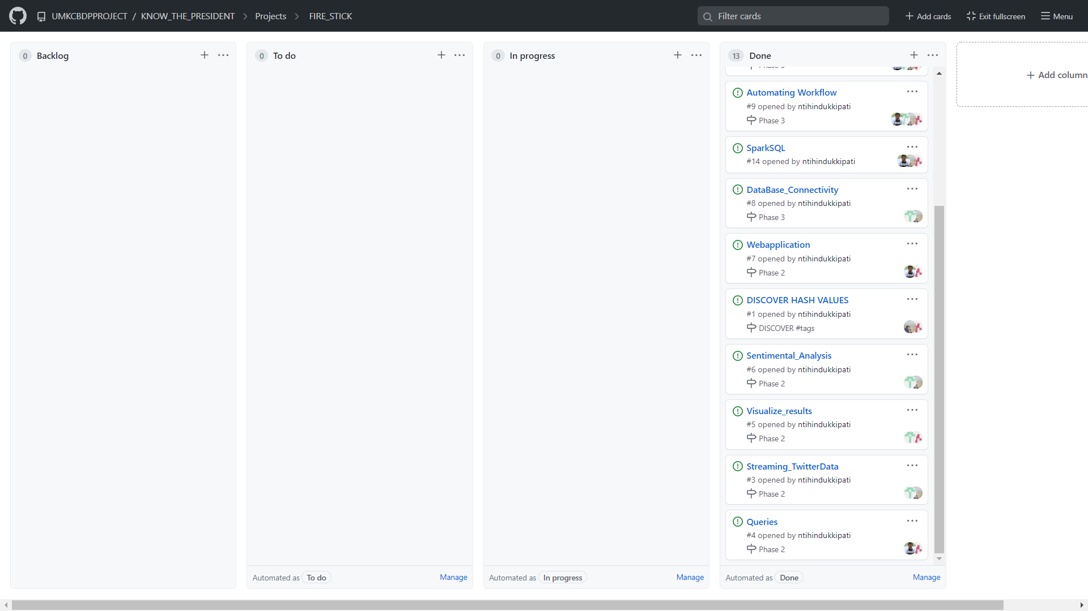

Slide 18
PHASE 1
Twitter Data Collection ( Chaitanya & Nikhitha)
Dataset Cleaning & Analysis ( Eswar & Nithin )

Slide 19
Twitter Data Collection
Before Streaming:
R&D on hashtags that relates to our source(Biden & Trump)
So far Findings #DonaldTrump, #CNN, #BCC, #JOEBIDEN, #US2020Elections

Slide 20
DATA ANALYSING & CLEANING
Playing with data and get to know what can be used.
Dealing with Special Characters and emojis.
Dealing with unlinked data.

Slide 21
PHASE 2
Spark ETL/Hive/SOLR
Analysis on the cold data
Visualization

Slide 22
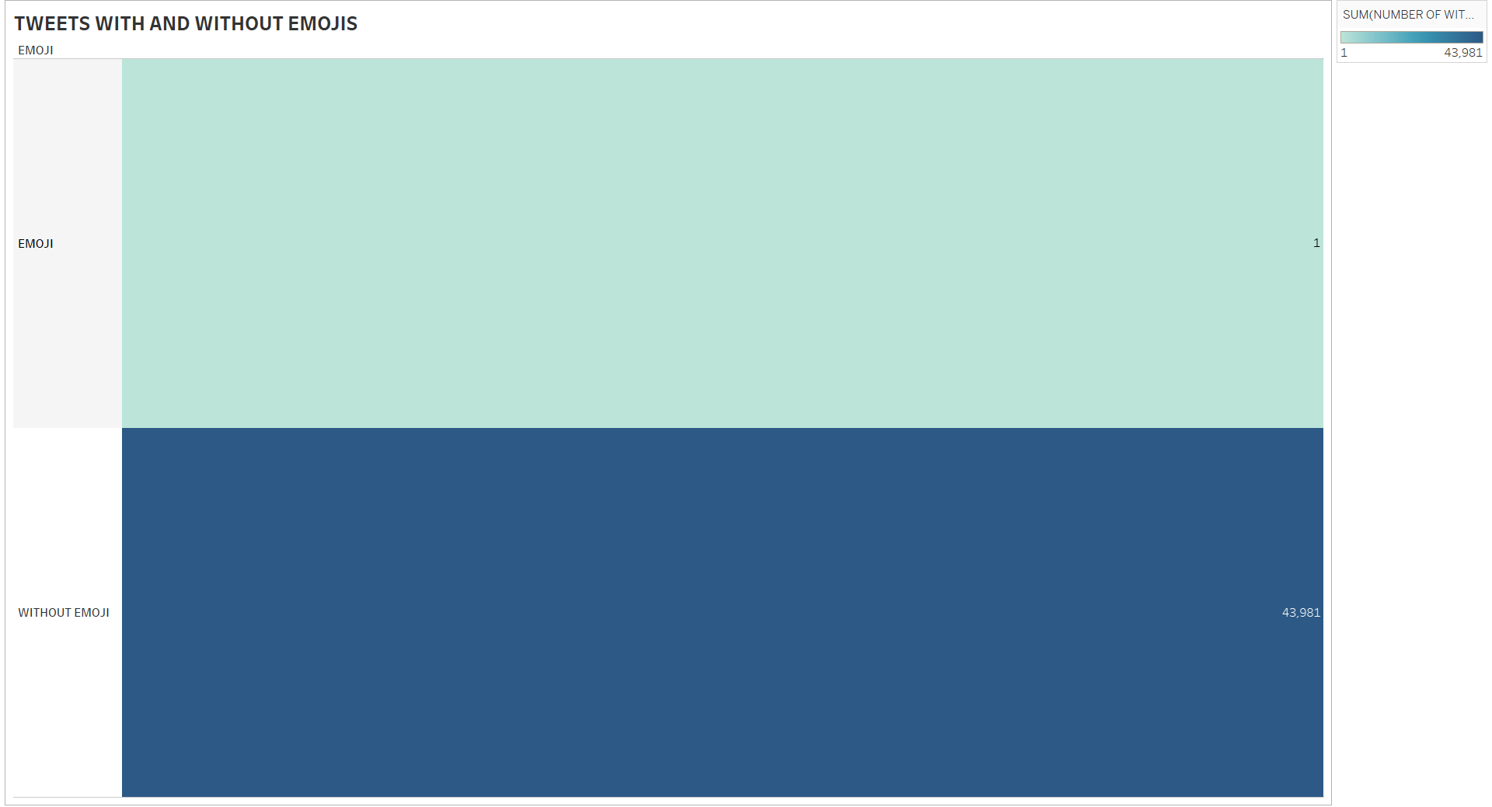
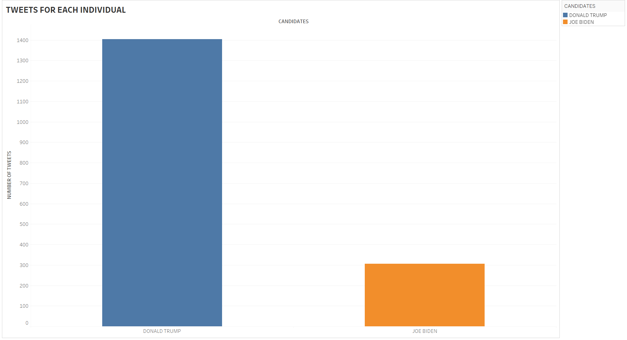
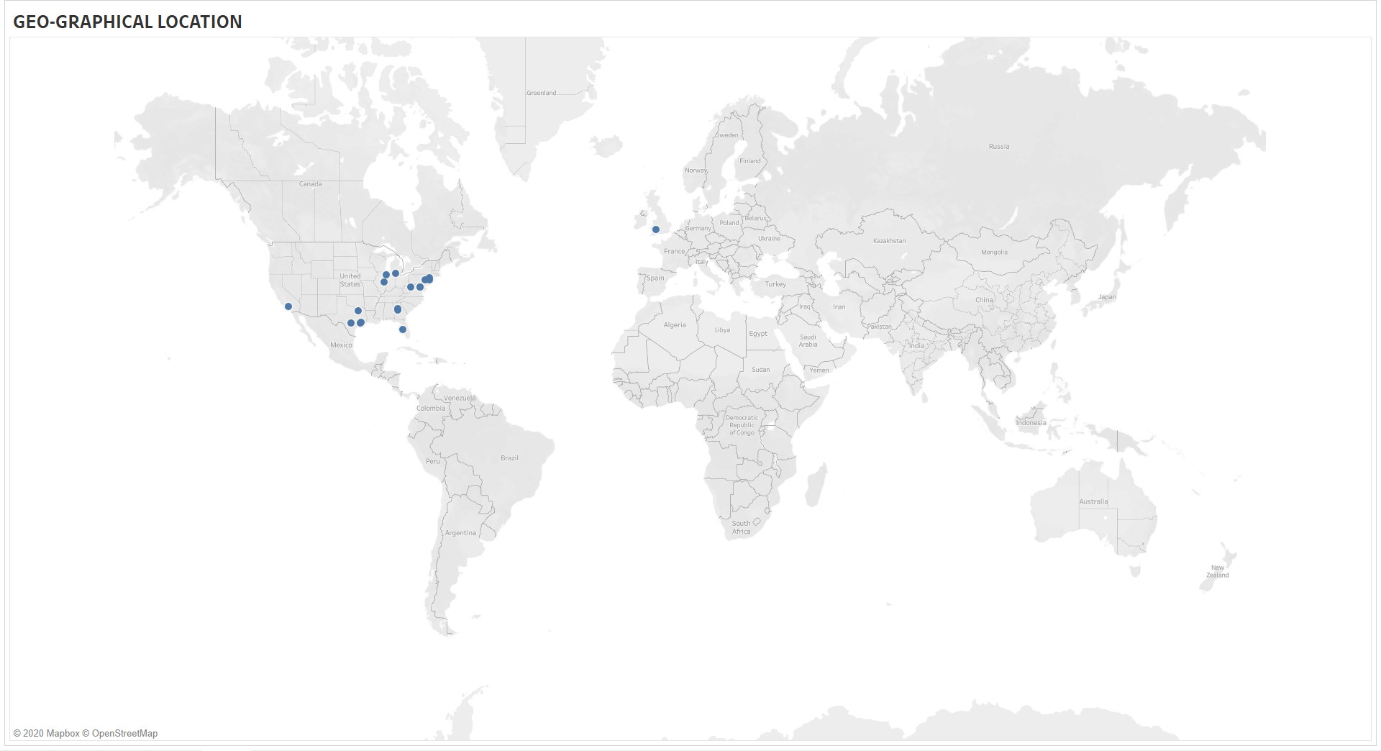
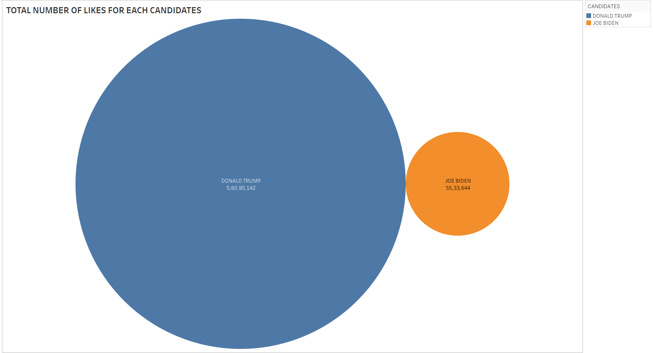
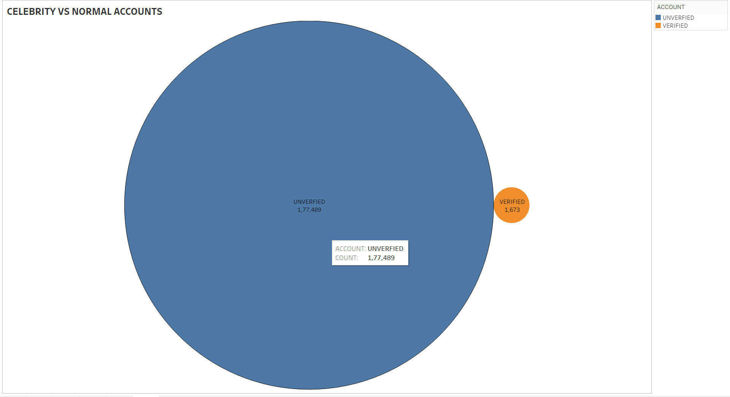
VISUALIZATIONS

Slide 23
PHASE 3
Spark Streaming, Sentiment Analysis
Uploading Results, Creating API in Cloud
Web Application using Flask
Deploying in Cloud

Slide 24
ARCHITECTURE

Slide 25
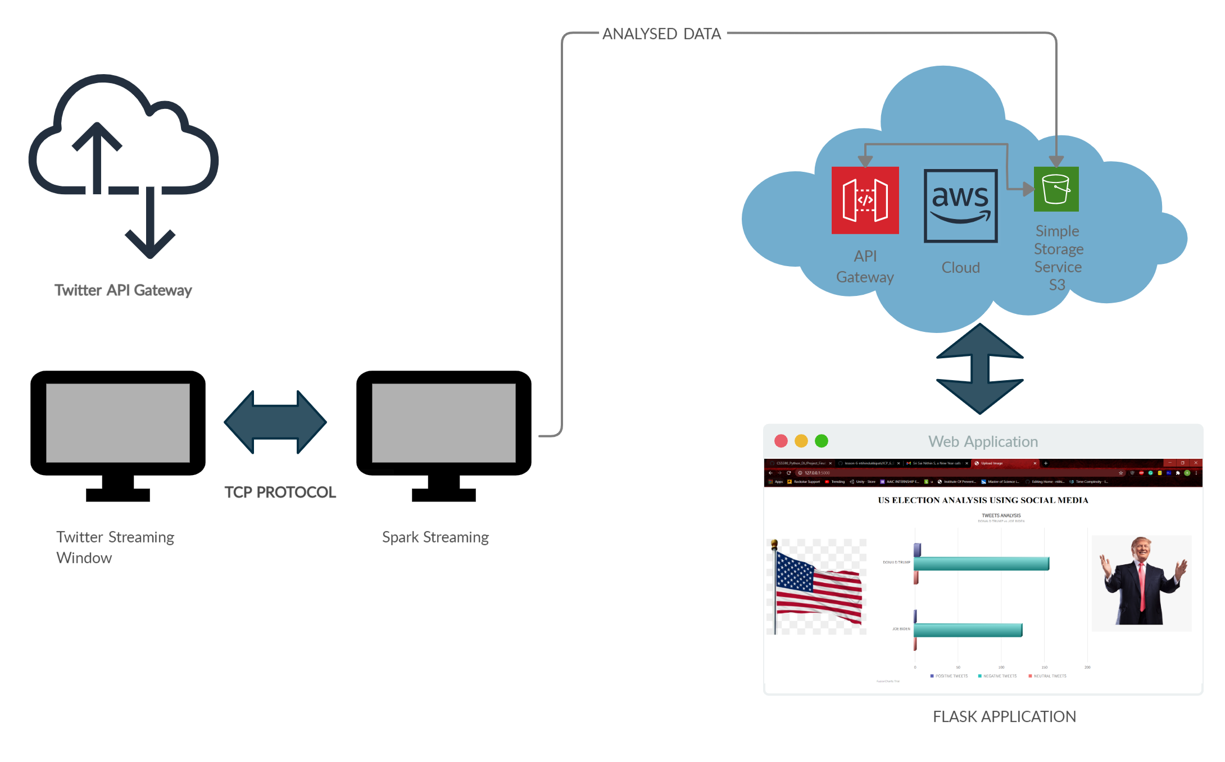

Slide 26
WORK FLOW

Slide 27
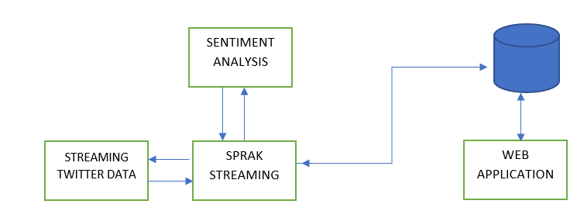

Slide 28
CODE SNIPPETS

Slide 29
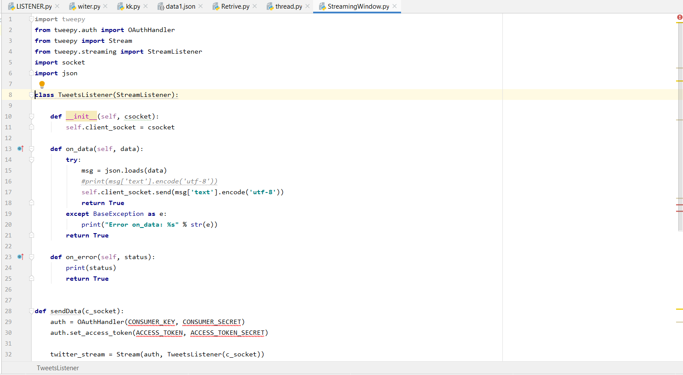

Slide 30
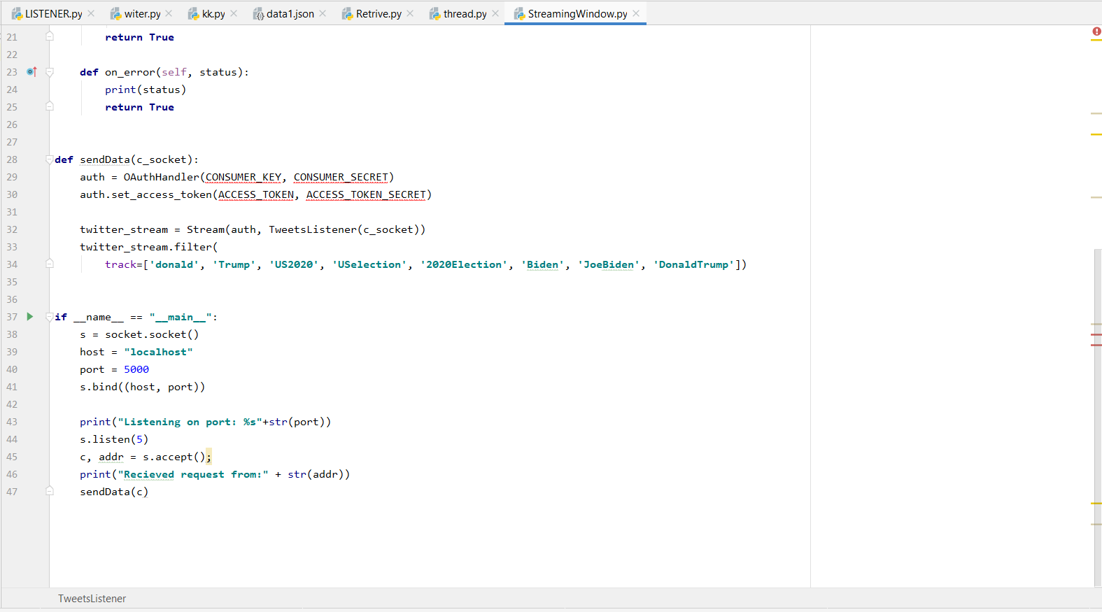

Slide 31
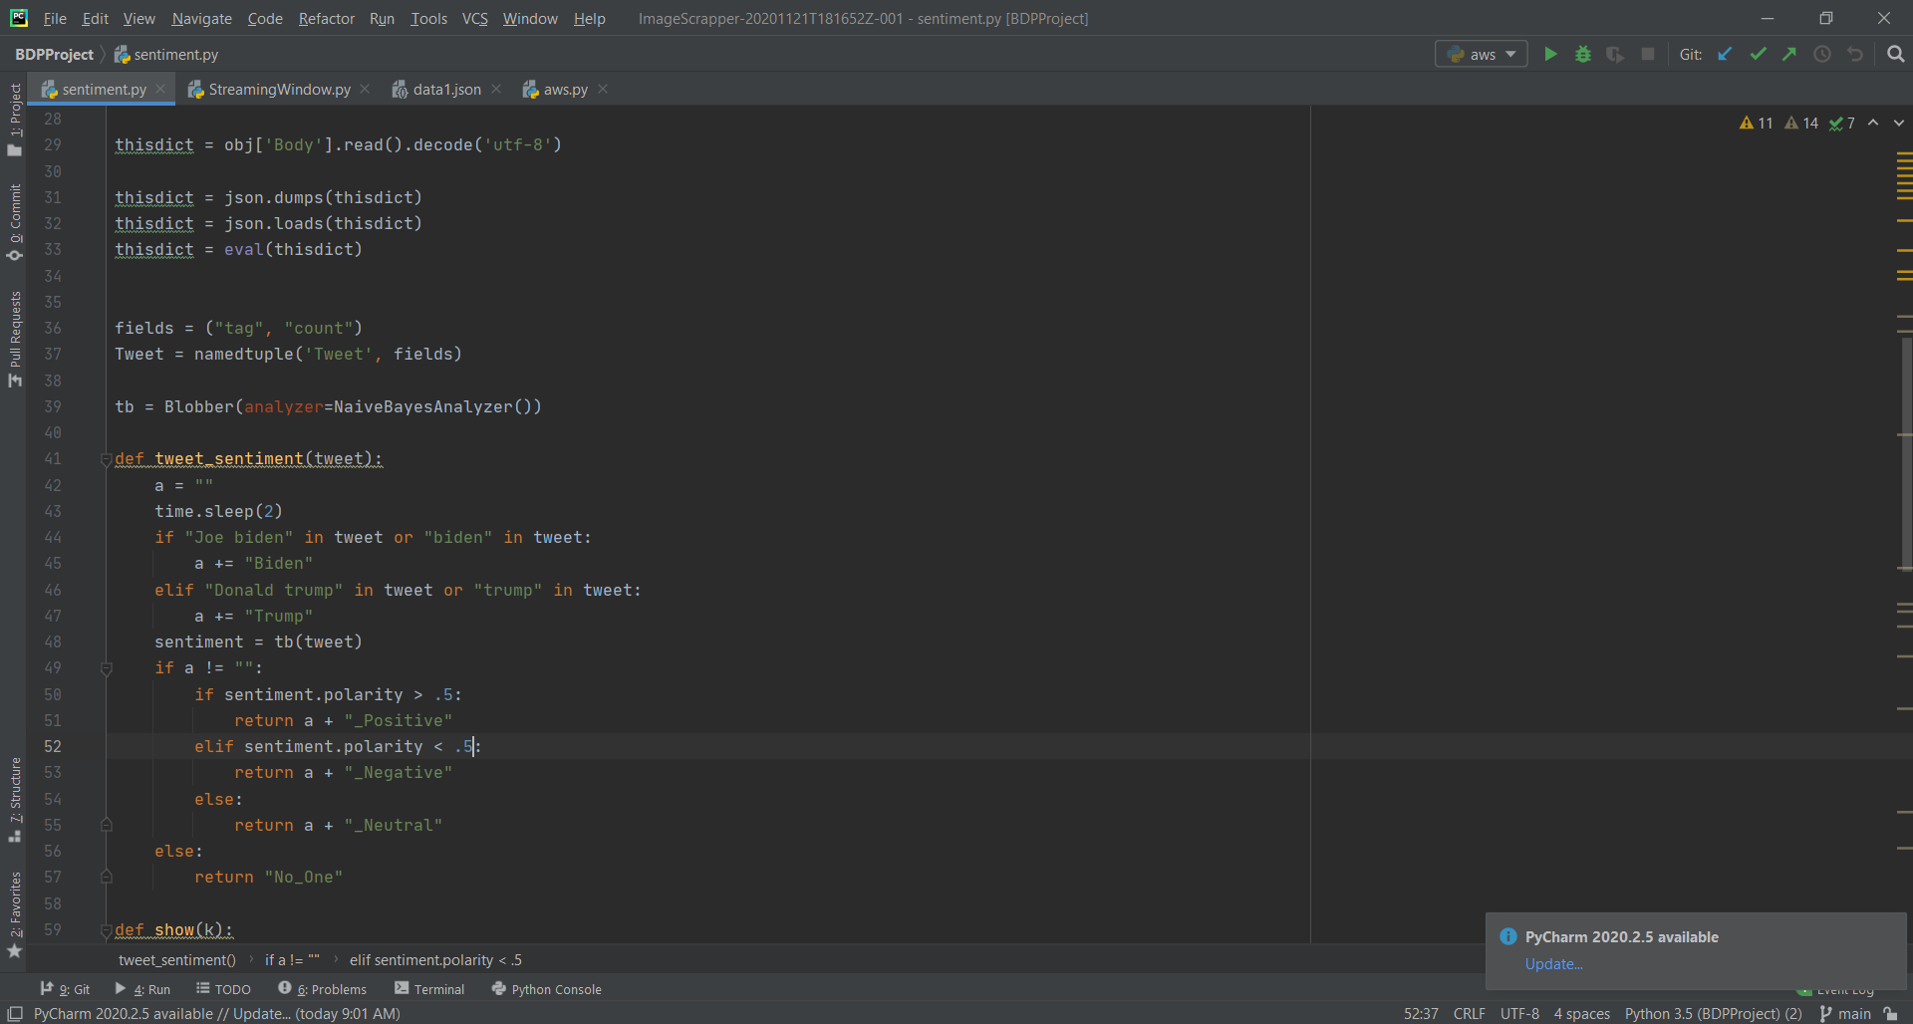

Slide 32
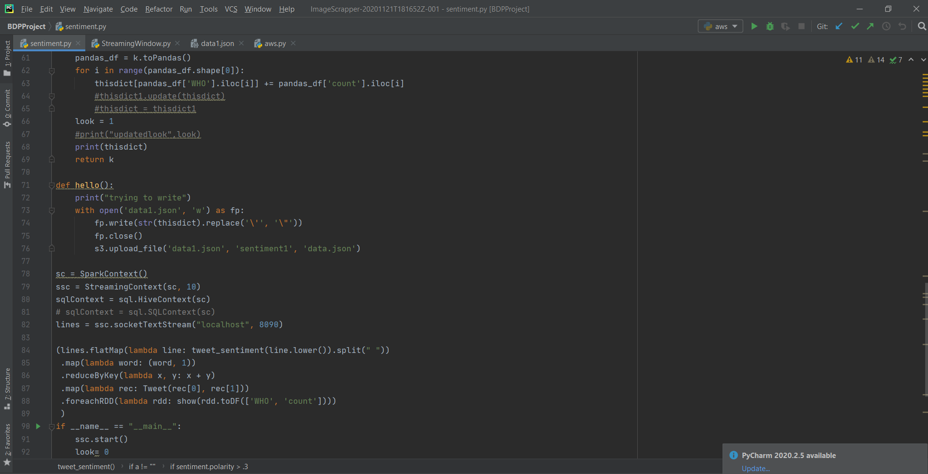

Slide 33
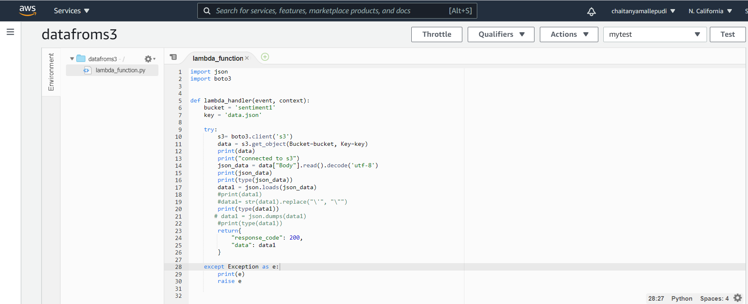

Slide 34
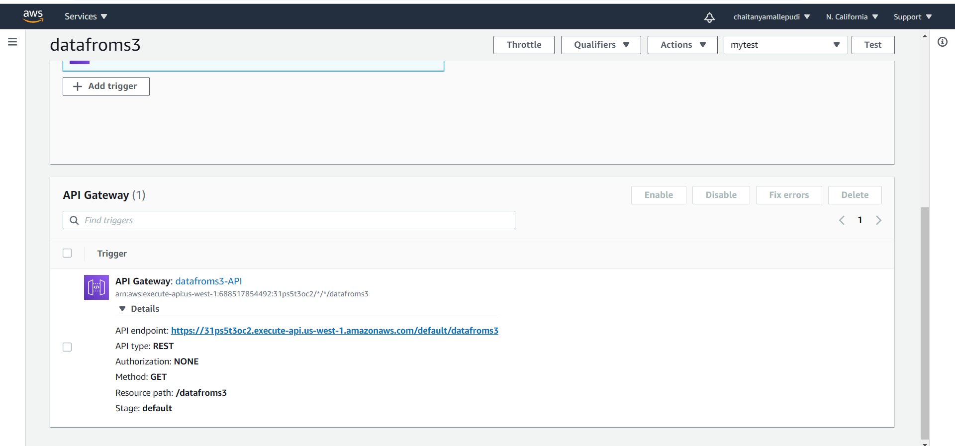

Slide 35
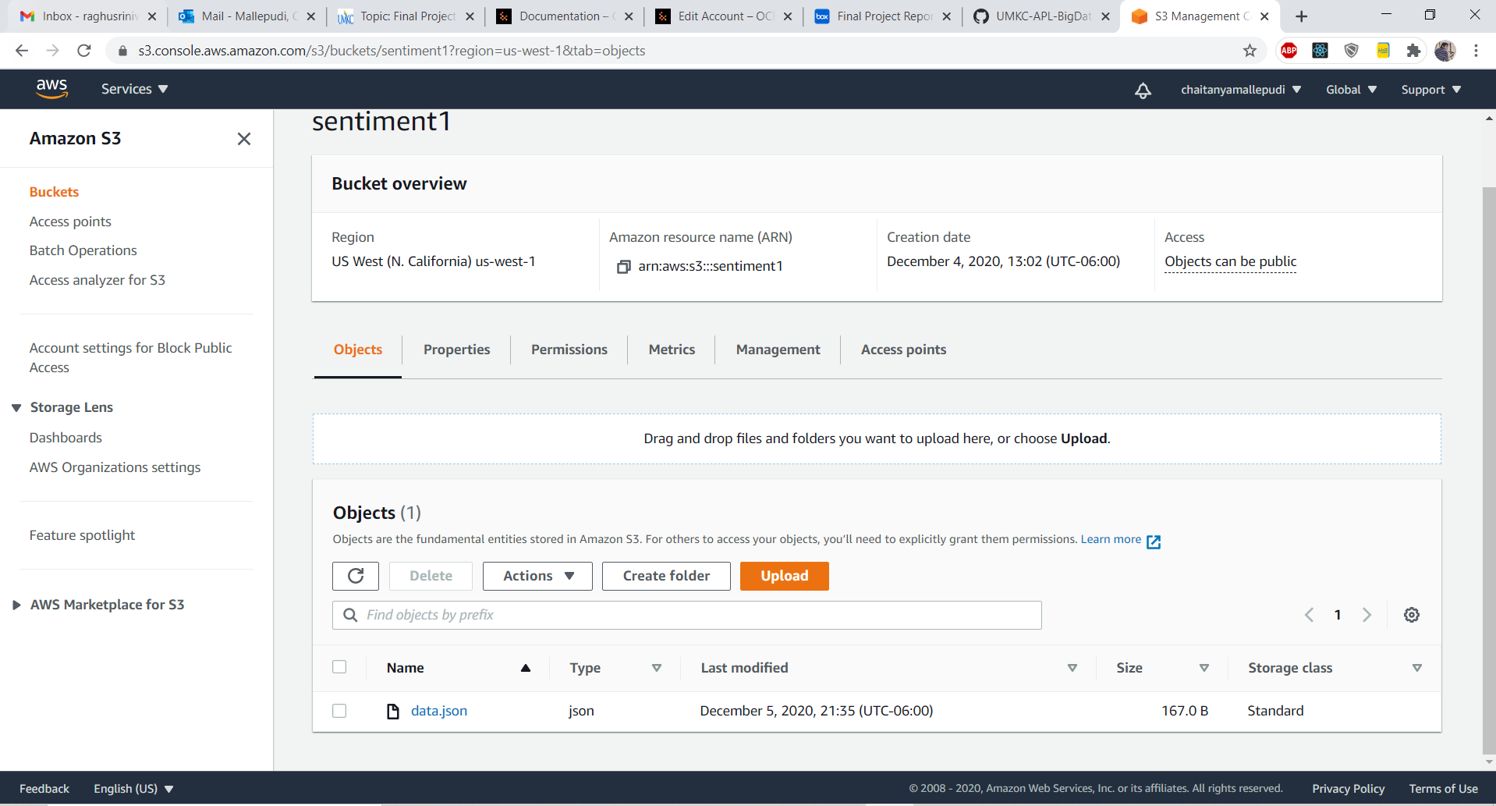

Slide 36
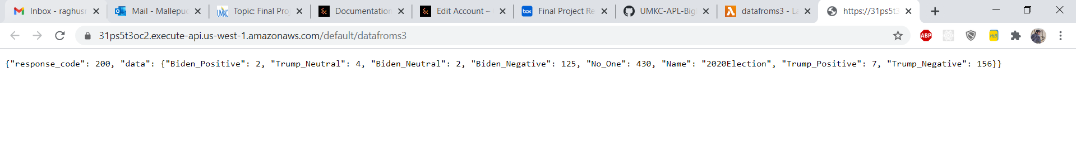

Slide 37
WEB APPLICATION

Slide 38
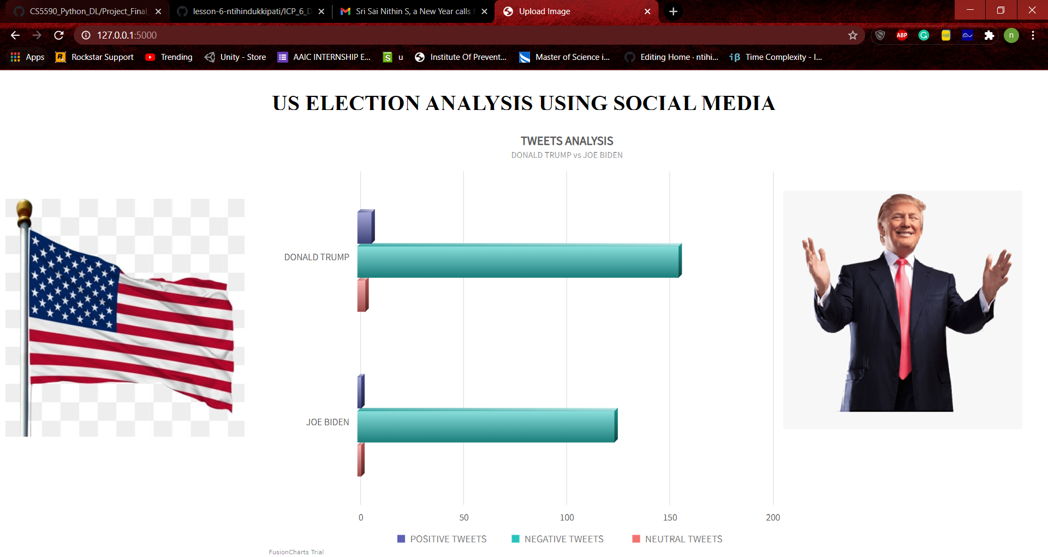

Slide 39
REFERENCES
https://medium.com/@anicolaspp/spark-streaming-and-twitter-sentiment-analysis-c860938d484
https://www.youtube.com/watch?v=uD_q4Rm4i2Q
https://www.edureka.co/blog/spark-streaming/
https://stackoverflow.com/questions/31466435/how-to-find-source-of-scala-matcherror
https://github.com/PacktPublishing/Hands-On-Deep-Learning-with-Apache-Spark/issues/1
https://docs.aws.amazon.com/s3/index.html?nc2=h_ql_doc_s3
https://docs.aws.amazon.com/apigateway/index.html

Slide 40

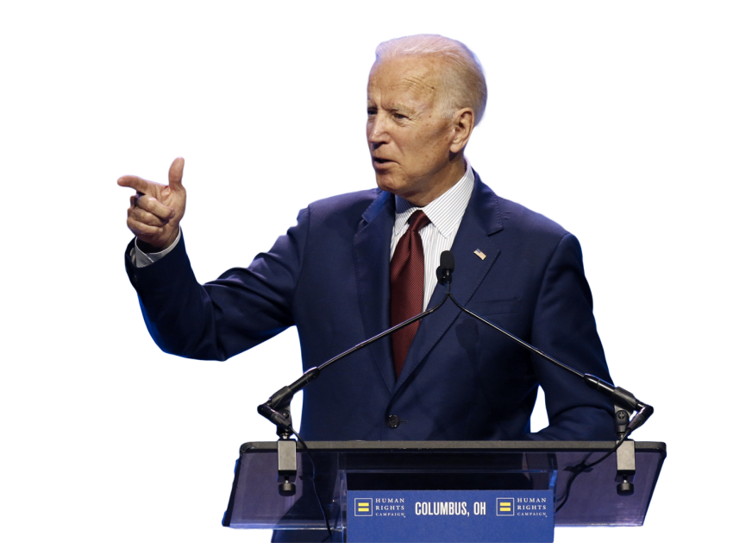
THANK YOU

